Slide 1

Fast Food Analysis
Analyzing Fast Food restaurants against health data and population demographics in California counties
By: The Git Pandas
Dominica Corless, Jeremy Steele,
Jeremy Jang, Stanley Tan & Kelsey Cox

Slide 2
OBJECTIVE
The intent of this project is to find correlations between Fast Food restaurants, California County demographics and Health issues.
Questions we intend to answer:
Is there any link between Fast Food restaurant population and obesity in the area?
Are Fast Food restaurants more common in lower income areas?
What is the concentration of Fast Food restaurants in the selected county?
How high is the concentration of these health factors in our population areas?
We will be analyzing Census data for populations and demographics from the California Census*, Fast Food Data from the US Department of Agriculture*, and Health Data from the CDC*.
* Fast Food Data: [United States Department of Agriculture](https://www.ers.usda.gov/data-products/food-environment-atlas/go-to-the-atlas/).
* California Census Data came from the Census API: [Census Package](https://github.com/datamade/census).
* Health Data: [CDC](https://gis.cdc.gov/grasp/diabetes/DiabetesAtlas.html).

Slide 3
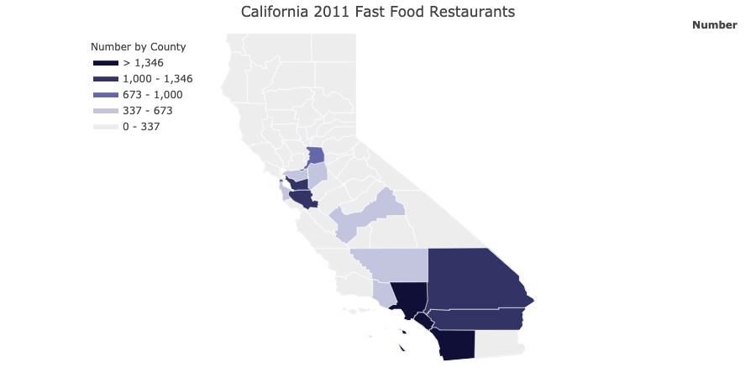
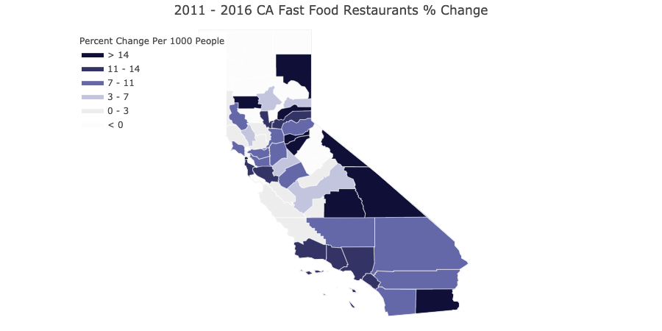

Fast Food Restaurants Per County in California
A visible concentration in Southern CA.
Majority of counties experienced a very large percent change here. Possibly due to Population increase.

Slide 4
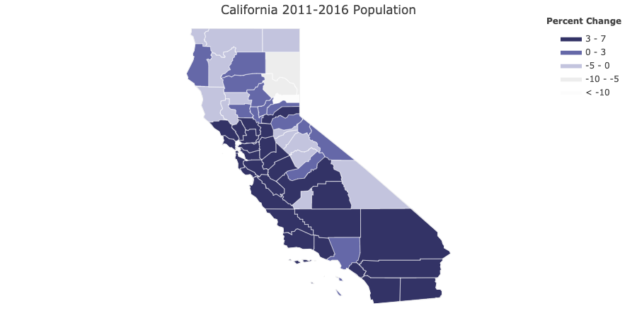
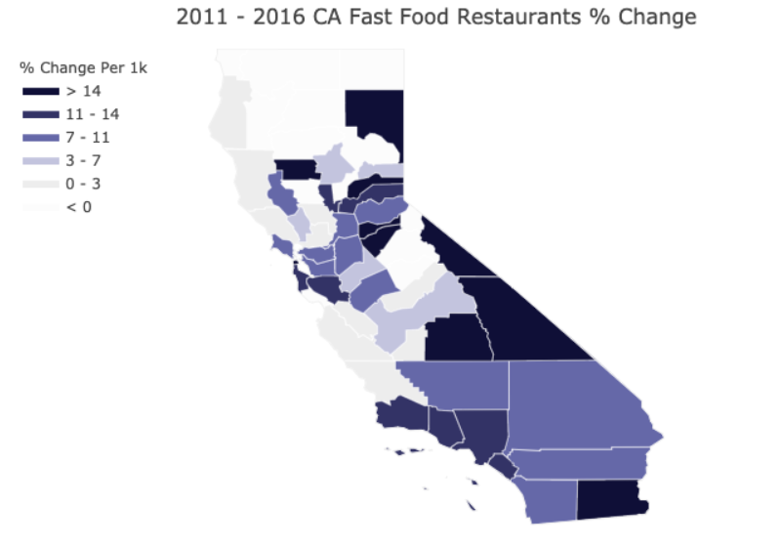
POPULATION VS FAST FOOD CHANGE
Majority of California counties experienced a 3-7% change between the years 2011 to 2016.
Most counties experienced a growth in Fast Food restaurants between the years 2011-2016.

Slide 5
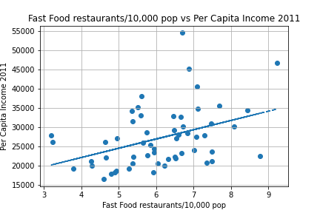
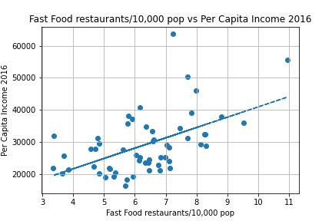
FAST Food vs PER CAPITA INCOME
R value: 0.397767101106243
R-squared value: 0.15821866672246415
R value: 0.5266912680213057
R-squared value: 0.2774036918098909

Slide 6
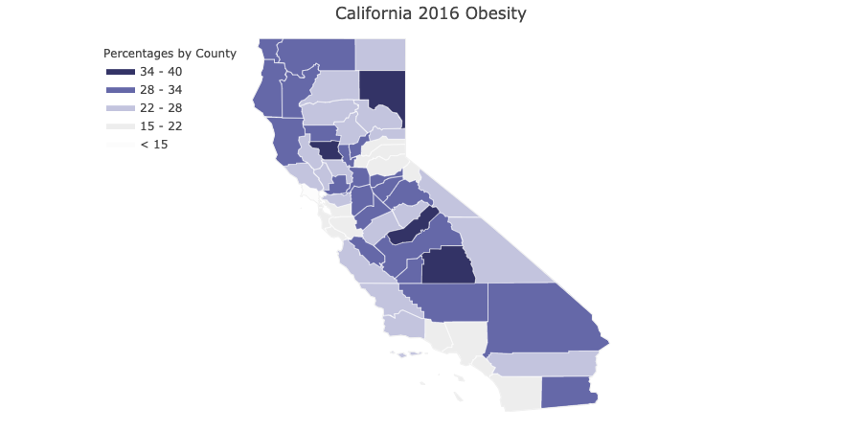
Fast Food vS Obesity Map

Slide 7
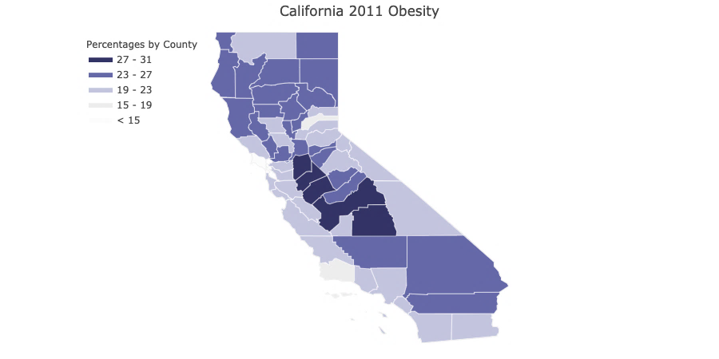

Obesity Rate by county

Slide 8
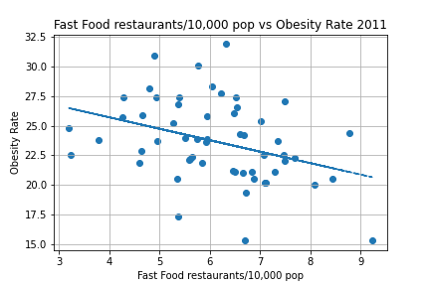
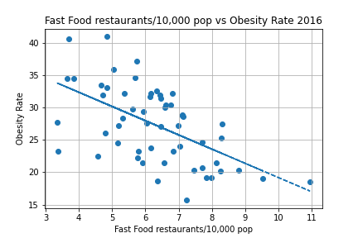
Obesity VS Fast Food
R value: -0.3588707718009065
R-squared value: 0.1287882308529783
R value: -0.5707195340440635
R-squared value: 0.32572078653947295

Slide 9
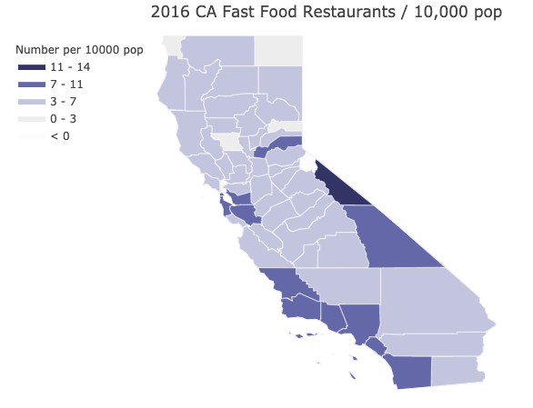
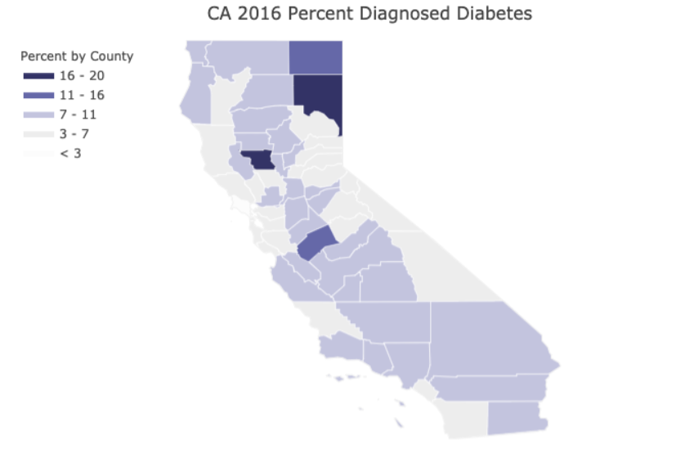
FAST FOOD VS DIABETES

Slide 10
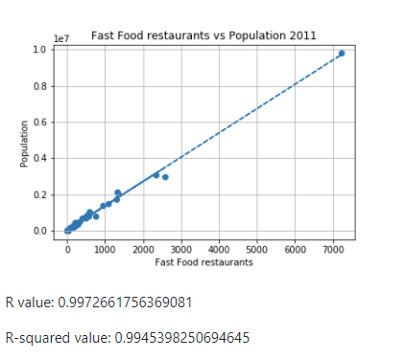
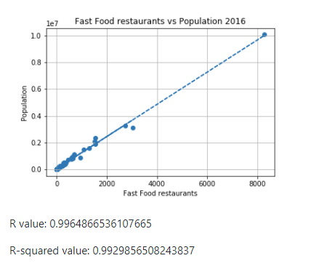
Fast Food Restaurants VS population
We can see a there is a strong positive correlation of more fast foods restaurants in areas of higher population.

Slide 11
OUR FINDINGS SO FAR…
Obesity rates are far lower in coastal counties that feature a higher incomes per capita.
These counties also feature the highest rates for college education and higher incomes.
There is a visible concentration of Fast Food restaurants in Southern CA. Maybe Tourism is a factor?
Majority of CA counties experienced a very large percent change growth over the years 2011-2016.
Chain restaurants may expand according to increased demand brought on by population growth

Slide 12
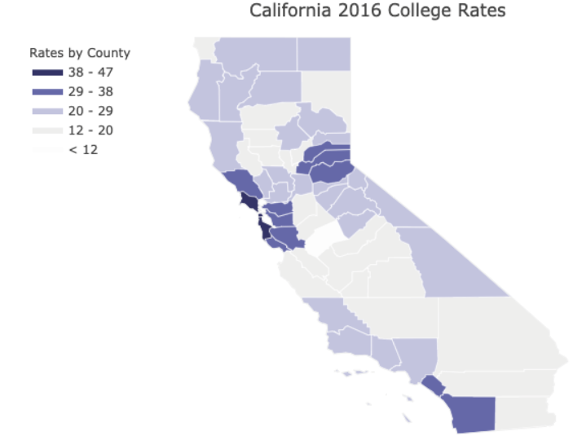
OBESITY VS COLLEGE RATES

Slide 13
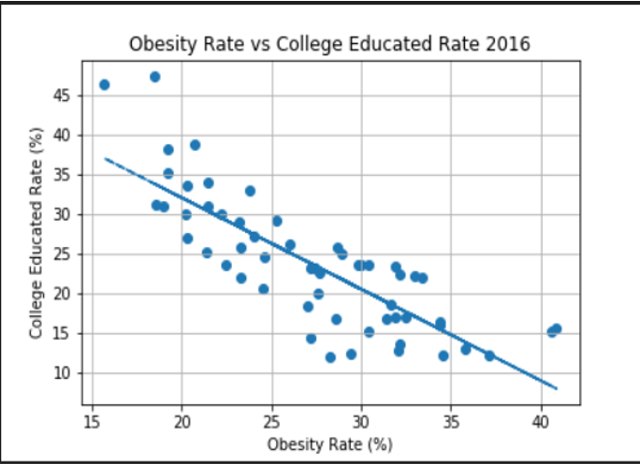
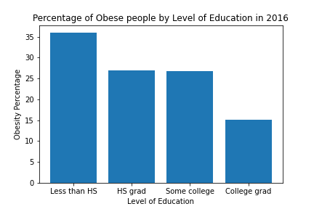
OBESITY VS COLLEGE EDUCATION
R value: -0.8120860848378118 R-squared value: 0.6594838091872056
Strong correlation exists that college educated individuals are less likely to be obese.
Are educated people more likely to be more health conscious?
Or do they have higher incomes that allow for better food options?

Slide 14
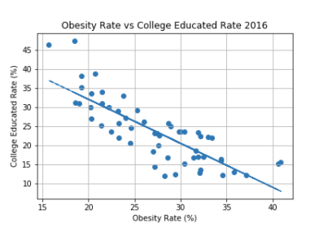
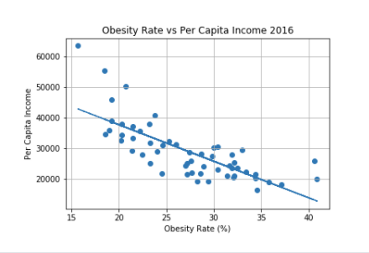
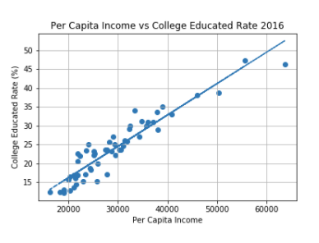
OBESITY VS INCOME VS EDUCATION
R value: -0.8120860848378118
R-squared value: 0.6594838091872056
R value: -0.7532467718723405
R-squared value: 0.5673806993361017
R value: 0.9404077031123526
R-squared value: 0.8843666480730507

Slide 15
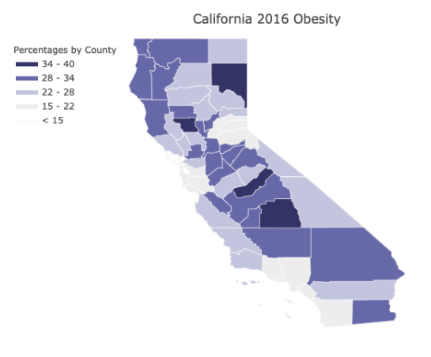
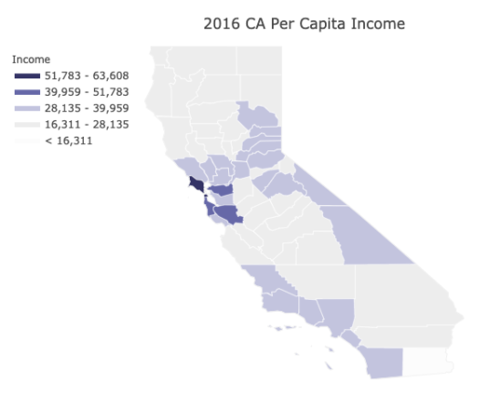
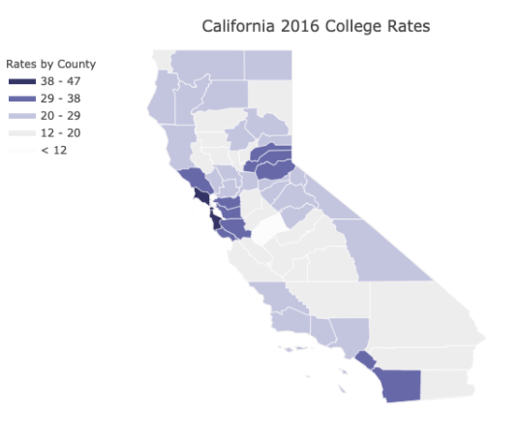
OBESITY VS INCOME VS EDUCATION
The strong negative correlations between obesity & college and obesity & income show a relationship between obesity and income.
College education usually leads to a higher income and a higher income may yield access to healthier food options.

Slide 16
CONCLUSIONS
Strong correlation exists that college educated individuals are less likely to be obese. Are educated people more likely to be more health conscious? Or do they have higher incomes that allow for better food options? Higher incomes may lead to access to healthier food options that may lower risk of obesity.
SUMMARIZE, INCONCLUSIVE
FURTHER RESEARCH ON PROFIT
CORRELATION WITH PROFIT?

